Slide 1
Real-Time Programming (II)

Slide 2
Topics
Signal and Data Acquisition
General Rate Monotonic Scheduling

Slide 3
Signal and Data Acquisition

Slide 4
Direct (memory) Addressing
The physical address is 20 bits, but the data segment register has only 16 bits. How can we create 20 bit address using 16 bit DS register?
Intel’s solution is: 1) shift the DS value 4 bits to the left (16 + 4 = 20)
2) add a 16 bit offset to address 64k locations
Example: How to move 10H to memory location 17000H? Suppose that we would like the segment to start at 10000H.
  MOV AX, 1000H
  MOV DS, AX (MOV DS,1000H is not allowed)
  MOV AX, 10H
  MOV [7000H], AX
16 bit DS Content
1000 H
7000H
17000H
16 bit offset
20bit BUS Address Lines

Slide 5
A/D & D/A Card Architecture
A modern A/D and D/A card has multiple ports starting from a selectable base address. These ports are organized as
  data register
  control and configuration
  status registers
For instances, the DAS-1600 Card’s base address is set at 300H (using jumpers). Some of the entries in the port function table in the manual is as follows:
  Address Read Function Write Function
  Base A/D (bits 0 - 3) starts A/D conversion
  (stores low byte bits 4..7)
  Base+1 A/D (bits 4 - 11) N/A
  (stores high byte bits 0..7)
  Base+2 Channel Mux selection Set Channel Mux select
  Base +4 N/A D/A Ch 0 bits 0 - 3
  Base +5 N/A D/A Ch 0 bits 4 - 11
  Base + 8 status clear interrupt
  Base + 9 status sets card configuration

Slide 6
High Byte and Low Byte
The A/D and D/A conversion logic supports 12 bit conversion. However, its data register is only 8 bit wide. Thus, it uses 2 registers. For example, input Ch 0’s 12 bits are stored in Base and Base + 1.
Goal: data = 0 0 0 0 11 10 9 8 7 6 5 4 3 2 1 0
Address:
  Base 3 2 1 0 x x x x
  Base + 1 11 10 9 8 7 6 5 4
You need to
  Get HighByte from base+1 (bits 4 .. 11 of the 12 bit data)
  data = (HighByte << 8) to move the data into high byte
= 11 10 9 8 7 6 5 4 x x x x x x x x
  Get LowByte from base (bits 0 .. 3 of the 12 bit data plus 4 bits of junk)
  data = (data | LowByte)
= 11 10 9 8 7 6 5 4 3 2 1 0 x x x x
  data = (data >> 4) to get rid of the 4 bits of junk = 0 0 0 0 11 10 9 8 7 6 5 4 3 2 1 0

Slide 7
Control and Status Register
We need to initialize the card
  Set BASEADDR+9 to 0 disable interrupt and DMA.
  Set BASEADDR+8 to 0 clear trigger flip flop for interrupt
  Set BASEADDR+2 to 0 select analog input channel 0 (pin 37).
To sample the analog voltage and start the A/D conversion
  Set BASEADDR to 0
Once, the A/D conversion starts, your program must wait for the A/D conversion to complete. Bit 7 of BASEADDR+8 tells us whether the conversion is complete. Thus we AND the value with 0x80 (80H) to get Bit 7 and wait until the conversion is done.
  While(hw_input(BaseADDR+8) & 0x80 != 0) {}
  // ((BaseADDR+8) &(10000000))!=0)
Note: for certain cards, you need to re-initialize it for every read. Does your version of DAS1600 needs to do that? Check it out in your lab.
BASE
BASE+8
7 6
1: not ready

Slide 8
Digital Representation of Analog Voltage
The N = 12 bits can be configured by jumpers/switches to represent different analog voltage ranges,
  e.g., -2.5 V to +2.5 V, -5 V to +5 V and -10 V to +10 V.
What are these ranges for? What should be the rule in picking a range?

Slide 9
The General Conversion Rule
Covert the analogy voltages to a N-bit digital representation is a special case of measurement conversion.
Let’s take the range between water freezing and boiling points at sea level. The measure using Celsius is from 0 to 100 while the measure using Fahrenheit is from 32 to 212.
How can we convert from Celsius to Fahrenheit? Hint: The general conversion rule is derived from the observation that two different linear measures measure the same physical quantity must be proportional to each other. For example, 10% in range_1 map to 10% in range_2, and 70% in the range_1 map to ______% in range_2.
Class Quiz 1: How to convert 60c to Fahrenheit:
Class Quiz 2: Generalize your result in Quiz and find the general formula to convert from measure 1 to measure 2.
  Ans 1: (60/(100 - 0))*(212 - 32) + 32
    = 60 (180/100) + 32
    = 60 * 9/5 + 32 F
  Ans 2: ((measure_1 - Measure_1_Lower_Limit)/range_1)*range_2 + Measure_2_lower_limit.

Slide 10
A/D and D/A Mapping
A/D: ((_______ - _______)/(________))*(__________) + __________
((V - V_lower_limit)/(V_range))*(digital_range) (+ digital_lower_limit = 0)
D/A: ((________ - _______)/(________))*(__________) + __________
((digital_level)/digital_range)*analog_range + analog_lower_limit
Example: analog voltages range is -1 to +2v and the digital_levels are from 0 to 2^{n} – 1.
If 2^{n} – 1 = 3, the digital output is 2bits with a range of 3 - 0 = 3.
A/D: V = +1: ((1 - -1)/3)*3 + 0 = 2. That is, 10 binary: 10B
D/A: 10B: (2/3)*3 + (-1) = +1v

Slide 11
Single Ended Input
External voltage can be connected with A/D cards via single ended inputs or differential inputs.
Single ended input measures the difference between ground and the input signal. It is susceptible to EMI interference and voltage difference between grounds of the A/D card and the ground of the signal source. They are fine in a low noise lab environment.
+
To A/D
Vs
-
Vcm
Resistance
G2
G1

Slide 12
Differential Inputs
Differential connections are insensitive (e.g. up to 10 v) to ground differences and EMI.
However, electronically differential connections requires twice input lines. For example, DAS 1600 may have 16 single ended A/D inputs or 8 differential A/D inputs.
+
-
To A/D
Vs
+
-
Resistance
G2
G1

Slide 13
Analog switch
A mechanical switch is typically not fast enough for use in a computer system, although there are exceptions ( ie burgler alarm )
Analog switch is a Field Effect Transistor (FET)
  Control the channel resistance by the gate voltage
Signal direction
Gate signal = 1
No signal
Gate signal = 0
Analog input
Gate
Works just like mechanical switch except the switching time is much less ( < 1 microsecond )
No mechanical switch.
Mechanical switches are used for very high accuracy

Slide 14
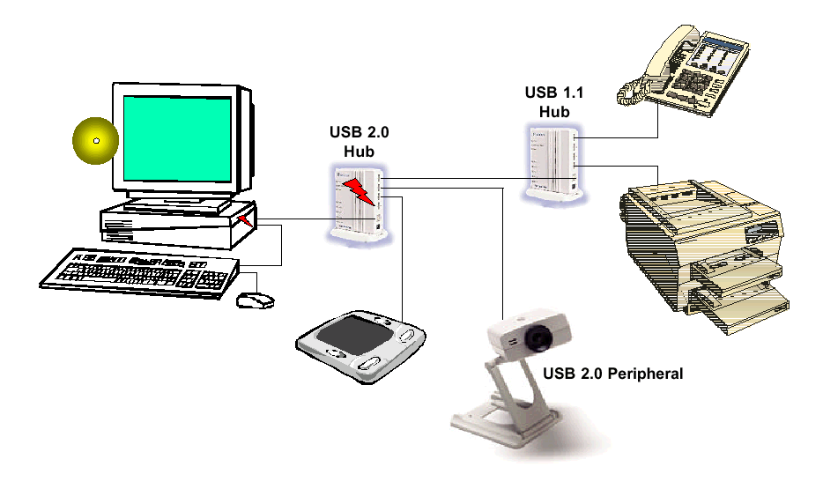
Serial Communication
Serial communication is economical and widely used: modem, mouse, keyboard, Printer, Scanner, Digital camera, etc.

Slide 15
8-input, 8-bit A/D system
Convert
Computer
System
Signal Conditioning
Output Port 0: bit 0
Interrupt input port
Data ready/EOC
Analog input
Channel 1
A/D
Converter
D0
Analog input
Channel 2
Input port 1
D7
Analog input
Channel 3
8-bit digitized data
Sample
and
Hold
Analog input
Channel 4
Analog Multiplexor
Analog input
Channel 5
Analog input
Channel 6
Analog input
Channel 7
S / H
Output port 0: bit 1
Channel select 0
Output port 0: bit 2
Analog input
Channel 8
Channel select 1
Output port 0: bit 3
Channel select 2
Output port 0: bit 4

Slide 16
Sample and hold
Store the input signal on a capacitor until the A/D converter can digitize the signal.
Special circuit design holds the voltage with minimal loss of charge.
Input signal is stored by capacitor as charge.
S/H input
S/H output
System logic
Sample:
SW1 closed
SW2 open
Hold:
SW1 open
SW2 closed
SW1
SW2
Storage
Capacitor
++++
SW 1 Control
SW 2 Control
S / H logic controller
S / H

Slide 17
A/D converter resolution
Resolution of an A/D converter determines its ability to measure differences in small values
  Resolution and accuracy are not the same
Example: An 8-bit A/D converter can digitize it’s input range into 255 discrete steps
  If the input voltage range is 0 to 10 Volts, then resolution is 10/255 = .04 volts per step
Consider a 16-bit A/D converter over the same voltage range
  10/65,535 = .00015 volts per step resolution
Typically, you will want to amplify the signal voltage so that you can take advantage of the resolution of the converter
  Example: If the input voltage is 0.00015 volts, then we have 1 bit resolution available from our 16-bit A/D converter

Slide 18
Serial I/O Basics
Coding
  Bit rate
  Clock synchronization
Major concern (Protocol)
  How to split the incoming data stream into individual units, bits, bytes and packets
  How does the receiver know where a data word starts and where it stops?
  How to configure and control different devices and their configurations?

Slide 19
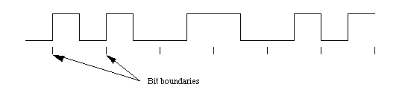
Manchester Code (IEEE Definition)
Two conflicting requirements
  Synchronization of sender’s and receiver’s clocks (more High-Low Transitions help)
  Bit rates. Cables have capacitance. The more is the transition, the higher is the frequencies and the more is the demand on the quality of cables. (Less transitions are better. Why?)
Manchester code is “clock friendly”. It is used in 10 Mbit Ethernet. It always has a transition in the middle. One to zero transition is 0. Zero to one transition is 1. So what is the code here?
0 0 1 0 1 1

Slide 20
Non Return to Zero Inverted (NRZI) Code
However, Manchester code is not bit rate friendly. It has one transition per bit, so that high speed USB and 100 Mbits dump it and use non zero return invert code.
If there is a transition at the beginning, it is 1. Otherwise, it is zero. What is this code under NRZI?
1 1 0 1 1 0 1 1 1 0 0

Slide 21
Asynchronous vs. Synchronous
Asynchronous (e.g., UART, character by character)
  Transmitter’s and receiver’s clocks are not synchronized.
  Very old (slower) transmission system (telephone,Morse code, etc.)
  Time interval between successive data may vary.
  Character oriented (ASCII: 7 bit, Unicode: 16bit)
  Receiver’s clock is typically 16x of bit rate
Synchronous (e.g., USB, frame by frame)
  More efficient (w/o start and stop bits)
  Clocks between transmitter and receive needs to be synchronized periodically, e.g., USB synchronizes clocks packet by packet

Slide 22
UART
From the viewpoint of the computer, UART is a pair of I/O ports
UART clock: 8x, 16x, 64x times the bit rate. After a frame starts, it is used count and find the approximate CENTER of a bit for sampling.
(what is the advantage of having a faster clock rate?)
UART control and status registers
  number of data bits, number of stop bits
  flow control - slow down the sender if it is too fast for the receiver
  use parity bit or not, even or odd if used
  16, 32 or 64 byte FIFO data buffers are used to reduce the interrupts to the computer.
  interrupt is normally enabled, telling the computer it has completed the sending or has received data. If interrupt is disabled, the UART has to be checked periodically.

Slide 23
Asynchronous Communication Basics
stop bits
Bo
B1
B7
start bit
parity bit (optional)
Sender and receivers clocks runs at the SAME rate but not synchronized.
The clocks run 8x, 16x, or 64x of the bit rate. The idle (normal) line logic is 1, no frame being transmitted.
When the line drops to zero after idle, it signals the start of a frame
If 16x is used, after 7 (or 8 if parity is enabled) bits, sender goes to 1 for at least 1 bit (stop bit) to signal the end of a frame. (Is it necessary? Why?)
Efficiency: 7/(7 + 3) = 70%
Notes:
There is no guarantee that the clock rate on sender and receiver are the same. The last transition will signal the end of transmission.
7+3: where 3 includes the start bit, parity bit, and stop bit.

Slide 24
Pseudo Code for Receiving Frames
In real world, the pulse will not be rectangular after traveling a distance. The following pseudo code tries to sample the middle of the pulse.
Loop
  Wait for a start bit(high-low transition) ; //causes the UART to start //receiving the data
  Set bit-counter to zero
  While (bit-counter<8) //the frame consists of 7 bits
    set tick-counter to count from 0 to 7 //the clock is 16x
    sample the signal and store the bit //approx middle of bit time
    set tick-counter to count from 0 to 7 again
    increment bit-counter
  EndWhile
  Check stop bit ; stop bit causes UART to go back to Idle state
  Report error if there is no stop bit
EndLoop
..

Slide 25
Flow Control
Software flow control (e.g. Xon - Xoff)
  Xon: start to transfer, 11 H.
  Xoff: stop transfer, 13H
  Receiver sends Xon/Xoff. Transmitter acts accordingly to avoid overflow the receiver’s buffer.
Hardware flow control
  uses RS-232’s request-to-send (RTS) and clear-to-send signal (CTS) lines.
  DTE (e.g. PC) asserts RTS when it wants to send data
  DCE (e.g. modem) asserts CTS when it is ready to receive data from the PC.

Slide 26
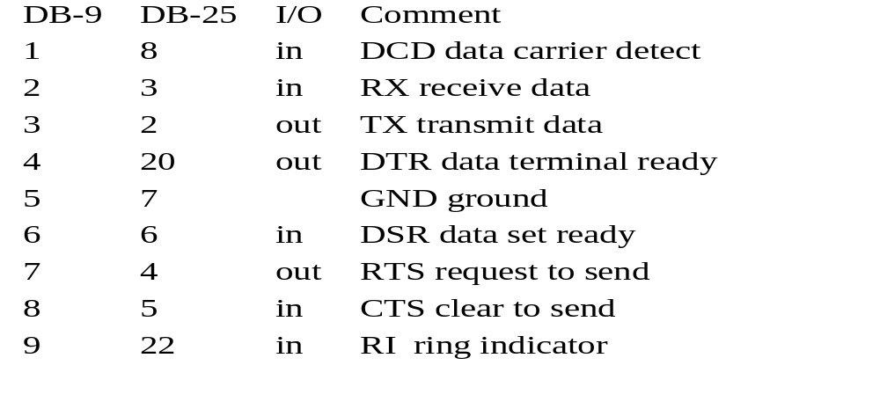
RS-232 (on the way out)
The comm. ports in PCs implement the RS232 standard
  DTE (data termination equipment) uses male connector
  DCE (data communication equipment) uses female connector
RS-232 signals are divided into data, status, control and ground.

Slide 27
Basic Ideas USB
USB can be thought as a simplified small “master – slave” LAN.
Up to 127 devices, you may hot swap connections
Standardized data format and control to support plug and play
Use polling to check if a device is present or absent
Use a sync byte to get clocks sync for each packet (DPLL)
Use token packet to control and data packet for communication
Packet IDentification (PID)code tells the nature of the packet, e.g.
E1H/69H | Out/IN | Token | Host to Device/Device to Host
D2H/5AH | ACK/NACK | Token | Ready to receive/Not Ready
2DH | SET UP | Token | Set up command
C3H/4BH | Data Packet Even/Odd | Data Up to 1023byte | Data packets

Slide 28
Digital Phase Lock Loop
A phase lock loop (PLL) is an electronic circuit that adjusts a local oscillator so as to keep a constant phase angle relative to a reference signal
In digital data communication, the signal are square waves (1’s and 0’s). A digital phase lock loop (DPLL) is a FSM that adjusts the local clock (oscillator), so that the sending side’s and receiving side’s clocks are synchronized with respect to the reference signal.

Slide 29
Operation of DPLL
Suppose that we use 8x sampling, Manchester code and that our synchronization pattern is three 1’s in a row, the following is what we’ve got in the buffer (NRZI is actually used in USB)
  000011110000111100001111 3 1’s in a row. This is perfect
  11 0000111100001111000011 missing the first 000011
Identify if local clock is too fast or too slow.
Adjusted the local clock (count in the clock counter) accordingly.

Slide 30
Summary
In this lecture you have learned
  I/O instructions
  Inline Assembly
  The basics of a typical A/D - D/A card

Slide 31
General Rate Monotonic Scheduling

Slide 32
Announcement
You have learned to program concurrent tasks for real time applications. When you have many real time tasks.
  How do you know if the deadline of all the tasks can be met?
  What happens if you modified a task, can the rest of task still meet their deadlines.
  ...
To answer these questions, we need to learn the basics of real time scheduling theory.
Reference: Sha, L., and Goodenough, J. B., “Real-Time Scheduling Theory and Ada”, IEEE Computers, April 1990. We will put a stack in the lab for you to pick up.
Notes:
2

Slide 33
Measure of Merit
 | Real time systems | Non-Real-Time Systems
Performance | Schedulable utilization (schedulability) | Throughput
Responsiveness | Worst case execution time of each task | Average response time
Overload | Stability (getting critical tasks done) | Fairness

Slide 34
A Sample Problem
Periodics Servers Aperiodics
100 msec
Emergency
T₁
50 msec
20 msec
Data Server
5 msec
2 msec
Deadline 6 msec after arrival
150 msec
20 msec
T₂
40 msec
Comm Server
Routine
10 msec
40 msec
350 msec
T₃
10 msec
2 msec
100 msec
Desired response 20 msec average
Notes:
13

Slide 35
What is GRMS for?
As the hardware becomes much faster and the RTOS market is gaining wide spread usage, the key required skills are no longer assembly programs executing on bare custom hardware.
The skills in demand now become the development of large and sophisticated multi-threaded real time applications.
GRMS is a practical theory that will enable you to design and analyze of multi-thread real time applications.

Slide 36
GRMS in Real World
"A major payoff...System designers can use this theory to predict whether task deadlines will be met long before the costly implementation phase of a project begins. It also eases the process of making modifications to application software." DoD 1991 Software Technology Strategy. pp. 8-15.
"Through the development of [Generalized] Rate Monotonic Scheduling, we now have a system that will allow [Space Station] Freedom's computers to budget their time, to choose between a variety of tasks, and decide not only which one to do first but how much time to spend in the process."
--- Aaron Cohen, former deputy administrator of NASA, "Charting The Future: Challenges and Promises Ahead of Space Exploration", October, 28, 1992, p. 3.
It also provides the theoretical foundation to solve MARS Pathfinders reset problem while it was on MARS. http://catless.ncl.ac.uk/Risks/19.49.html.
GRMS is supported by almost all the commercially available RTOS

Slide 37
Dynamic vs. “Static” Priority Scheduling in Theory
An instance of a task is called a job. “Static” priority assigns a (base) priority to all the jobs in a task. Dynamic priority scheduling adjust priorities in each task job by job.
What type of scheduling algorithm is used to schedule these two tasks?
An optimal dynamic scheduling algorithm is the earlier deadline first (EDF) algorithm. Jobs closer to deadlines will have high priority. With independent periodic tasks, all tasks will meet their deadlines as long as the processor utilization is less than 1.
An optimal “static” scheduling algorithm is the rate monotonic scheduling (RMS) algorithm. For a periodic task, the higher the rate (frequency) the higher the priority.
J_{1.1}
_{J1.2}
J_{2.1}
Notes:
10
For example, the parking brake is analytically redundant to the main brake with respect to the property, P_{i}, the range of braking force.
(answer EDF)

Slide 38
Periodic Tasks
A task T_{i} is said to be periodic if its inter-arrival time (period), P_{i}, is a constant.
Periodic tasks are common in real time systems because of the sampling actions.
(Can you give some examples?)
The utilization of task τ_{i}, is the ratio between its execution time C_{i} and its period P_{i}: U_{i} = C_{i} / P_{i}
The default deadline of a task is the end of period.

Slide 39
Importance and Priority
Task T₁ : if it does not get done in time, the world will end.
Task T₂: if it does not get done in time, you may miss a sweet dream.
Quiz: presume that the world is more important than your dream, should task T₁ has a higher priority?
Notes:
8

Slide 40
Why Faster Hardware is Not Enough
Τ₁
important
Τ₂
...
less important
If priorities are assigned according to importance, there is no lower bound of processor utilization, below which tasks deadlines can be guaranteed. (Why?)
C₁/P₁ + C₂/P₂ = U
U → 0, when C₂ → 0 and P₁ → ∞
Task T₂ will miss its deadline, as long as C₁ > P₂.
Notes:
9

Slide 41
Less Than 100% Utilization but not Schedulable
4
4
6
0 10 14
In this example, 2 tasks are scheduled under RMS, an optimal static priority method
4/10 + 6/14 = 0.83
note: if tasks periods are harmonic, e.g, 2, 4, 8, 16 etc, the utilization bound is 1

Slide 42
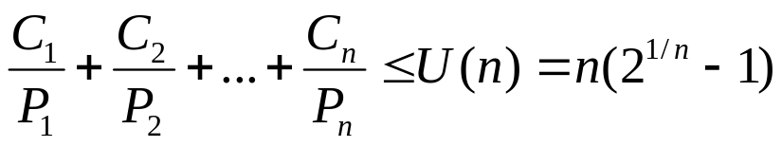
Schedulability: UB Test
Utilization bound(UB) test [Liu and Layland 73]: a set of n independent periodic tasks scheduled by the rate monotonic algorithm will always meet its deadlines, for all task phasing, if
  U(1) = 1.0 U(4) = 0.756 U(7) = 0.728
  U(2) = 0.828 U(5) = 0.743 U(8) = 0.724
  U(3) = 0.779 U(6) = 0.734 U(9) = 0.720
For harmonic task sets, the utilization bound is U(n)=1.00 for all n. For large n, the bound converges to ln 2 ~ 0.69.
Conventions, task 1 has shorter period than task 2 and so on.
Notes:
We say a set of tasks is schedulable if the task set is guaranteed to meet all its deadlines. The utilization bound test says that a task set is schedulable if its total utilization is less than a certain bound, called the Liu & Layland bound. The utilization bound test provides the basic formula underlying the theory. More complex formulas provide better bounds. This test is the application of a theorem, which was proved by Liu and Layland in “Scheduling Algorithms for Multiprogramming in a Hard Real-Time Environment”, JACM, 1973.
The utilization bound test assumes that:
1. The processor always executes the highest priority task.
2. Task priorities are assigned according to rate monotonic policy.
3. Tasks do not synchronize with each other.
4. Each task’s deadline is at the end of its period.
5. Tasks do not suspend themselves in the middle of computations.
The test takes into account the preemption time and execution time for each task under a worst-case combination of periods and execution times. As the number of tasks goes to infinity, the bound approaches ln(2) = 0.693; in other words, any number of independent periodic tasks will meet their deadlines if the total system utilization is under 69%
For a harmonic task set (in which the period of each task is a multiple of all higher-frequency tasks), the utilization bound is 1.0 for all task sets.

Slide 43
Sample Problem: Applying UB Test
 | Execution Time | Period | Utilization
Task T₁ | 20 | 100 | 0.200
Task T₂ | 40 | 150 | 0.267
Task T₃ | 100 | 350 | 0.286
Are all the tasks schedulable?
What if we double the execution time of task T₁?
Notes:
Since we are interested in worst-case behavior, tasks utilization are always rounded up. For example, U2 = 40/150 = .2666... becomes .267 and U3 = 100/350 = .2857143... becomes .286.
In this example, since the total utilization is under the bound for three tasks, all tasks are guaranteed to meet their deadlines, even under worst-case conditions. An additional 24.7% CPU capacity is available for lower-priority tasks that have no deadline.
Remember that there are several assumptions associated with the utilization bound test:
Zero context switch overhead.
Deadlines are at end of period.
No interrupts are used.
Priorities are assigned in rate monotonic order.
Tasks do not interact with one another.
Tasks do not suspend themselves.

Slide 44
The Exact Schedulability Test
Critical instant theorem: If a task meets its first deadline when all higher priority tasks are started at the same time, then this task’s future deadlines will always be met. The exact test for a task checks if this task can meet its first deadline [Liu73].
Τ₁
Τ₂
Timeline

Slide 45
Intuition for the Exact Schedulability Test
Suppose we have n tasks, and we pick a task, say i, to see if it is schedulable.
We initialize the testing by assuming all the higher priority tasks from 1 to i-1 will only preempt task i once. In other words, the initially presumed finishing time for task i is just the sum of C₁ to C_{i} , which we call a₀.
We now check the actual arrival of higher priority tasks within the duration a₀ and then presume that it will be all the preemption task i will experience. So we compute a₁ under this assumption.
We will repeat this process until one of the two conditions occur:
  The a_{n} eventually exceeds the deadline of task i. In this case we terminate the iteration and conclude that task i is not schedulable.
  The series a_{n} converges to a fixed point (I.e. it stops increasing). If this fixed point is less than the deadline, then the task is schedulable and we terminate the iteration.
Notes:
This remarkable theorem was proved by Liu and Layland and assumes:
Tasks are scheduled according to the rate monotonic algorithm.
Tasks are independent and do not interact.
Tasks do not suspend during execution.
The iterative formula for task response time was introduced in Joseph and Pandya, “Finding Response Times in a Real-Time System,” BCS Computing Journal, October 1986 (vol 29 no 5) pp 390-395.
The iterative formula is an application of fixed point iteration. Since the successive iterates are non-decreasing and approach the response time from below, the iterative formula is known to converge if there is a solution.
There is an alternative approach that we call the scheduling point version of the response time test (see slide 29). The mathematical characterization of this scheduling point version is presented in The Rate Monotonic Scheduling Algorithm -- Exact Characterization and Average Case Behavior, by Lehoczky, Sha, and Ding, Technical Report, Department of Statistics, Carnegie Mellon University, 1987. Also presented in this paper is the fact that for randomly generated task sets, the actual utilization bound is 88% rather than the worst-case bound of 69% presented in the UB test.

Slide 46
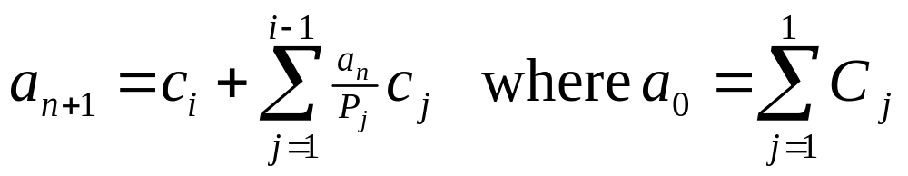
Exact Schedulability Test
Test terminates when a_{n+1} > P_{i} (not schedulable)
or when a_{n+1} = a_{n} < P_{i} (schedulable).
The subscript to a indicates the number of iterations in the calculation. The index i indicates it is the ith task being checked.
The index j runs from 1 to i-1, i.e., all the higher priority tasks. Recall from the convention - task 1 has a higher priority than task 2 and so on.

Slide 47
Example: Applying Exact Test -2
Use exact test to determine if τ₃ meets its first deadline:
3
∑
a
=
C
=
C
+
C
+
C
=
40
+
40
+
100
=
180
0
j
1
2
3
j
=
1
2
a
a
=
C
+
∑
0
C
1
3
P
j
j
=
1
j
=
100
+
180
(
180
40
)
+
(
40
)
=
100
+
80
+
80
=
260
100
150
Notes:
To apply the RT test, we do two steps
Use the iterative formula to compute the first response time W3 of t3.
Compare W3 to the first deadline for t3, namely T3.
If W3 < T3, then t3 is schedulable according to the RT test.
We start with an initial guess W3 = 0. This is labeled as the “zero-ith” iteration W3(0) = 0. To compute the first iteration, W3(1), we use the iteration formula with n = 0.
Substitute 0 for W3(0). All the terms in the summation drop out, so the first iteration is
W3(1) = C3 = 100.
Next we apply the formula with n=1 and n=2, and compute, respectively, W3(2) and W3(3). Since each successive iteration is different, the computation has not yet converged and we must continue.

Slide 48
Example: Applying the Exact Test -3
2
a
a
=
C
+
1
C
=
100
+
260
(40)
+
260
(40)
= 300
2
3
∑
j
j
P
100
150
=
1
j
2
a
a
=
C
+
2
C
=
100
+
300
(40)
+
300
(40)
= 300
3
3
∑
j
j
P
100
150
=
1
j
a
=
a
=
300
Done!
3
2
Task τ₃ is schedulable using exact test
a
=
300
<
P
=
350
3
Notes:
We continue by applying the iteration formula for n=3 and n=4.
Finally, the computed value for W3(5) is the same as W3(4).
W3(5) = W3(4) = 300.
The iteration has converged, and the first response time for t3 is
W3 = 300.
This must be compared to the first deadline for t3.
We have W3 < T3 since 300 < 350.
So t3 is schedulable using the response time test.

Slide 49
Timeline
0
100
200
300
τ
1
τ
2
τ
3
τ
completes its work at t = 300
3
Notes:
This slide illustrates an alternate version of the response time test based on scheduling points. Again, the test is being applied only to t3.
A scheduling point is a point in time when new work arrives; the beginning of a new period for some task in the task set. This version of the CT test checks to see if there exists a scheduling point (at or before the deadline of t3) at which all work initiated up to that point has been completed. Since the workload includes the compute time of t3 as well as all higher-priority tasks, if the work is completed, then t3 has met its deadline.
In this graphical representation of task execution under worst-case phasing, we can see that, when all tasks are ready to execute at t=0, task t3 cannot begin execution until t=80. As t3 tries to complete its work it gets preempted at the next scheduling point at t=100, where t1 introduces more work. Each time t3 resumes its work it is preempted before completion, until t=300. In this example, task t3 completes all its work at exactly the fourth scheduling point. It completes all its work before its first deadline at t=350, and is therefore schedulable.
The reason for introducing two ways to find the response time is that the iteration formula is easier to program, while the scheduling points are easier to visualize

Slide 50
Class Exercise
Suppose that we have three tasks
c₁ = 4, P₁ = 10
c₂ = 6.1, P₂ = 14
Use the exact formula to show task 2 is not schedulable. Draw a timeline to confirm that.
Can we add a task T₃ with C₃ = 1 and P₃ = 70. What would be the shortest period of T₃ that it can still meet its deadlines?

Slide 51
Summary
Today, we have introduced GRMS and the scheduling of periodic task.
We will then study synchronization protocols, the scheduling of aperiodic tasks and finally putting all them together.
We have now reviewed the UB test and exact test to determine if a set of independent periodic tasks are schedulable.
The schedulability analysis of independent periodic tasks are the foundation of GRMS and it is VERY IMPORTANT for you to master these test and can apply them correctly.
Next, we will take a more in depth look on the scheduling of periodic tasks

